Slide 1

Land Cover Change Detection using Neural Network for Satellite Images
Authors:
Ashkan Bozorgzad, Hari Prasad Renganathan, Karveandhan Palanisamy, Masataka Koga, Yewen Zhou, Yuki Ikeda
Fall 2022
Mentor: Dr. Saba Rahimi from J.P. Morgan
Instructor: Vivian S. Zhang from Columbia University

Slide 2
Problem Definition
Create high-resolution (1m / pixel) land cover change maps of Maryland, USA
low-resolution labels are available: NLCD (30m / pixel) or MODIS
Input Data:
Low-resolution labels
High-resolution input imagery
Machine Learning Models
Output:
Predict high-resolution labels
Predict land cover change
Labels: 4 target classes (Water, Tree Canopy, Low Vegetation, and Impervious)

Slide 3
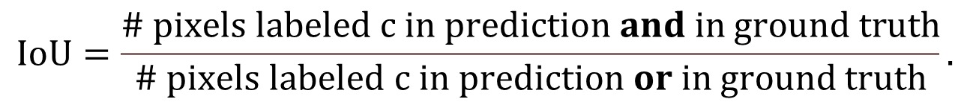
Problem Definition
The model can be applied to two different years (images)
the super-resolved label can be compared to estimate changes in the four classes
The evaluation metric: IoU (4 loss + 4 gain = 8 clases) :
$$IoU=\frac{\# pixels labeled c in prediction and in ground truth}{\# pixels labeled c in prediction or in ground truth}.$$

Slide 4
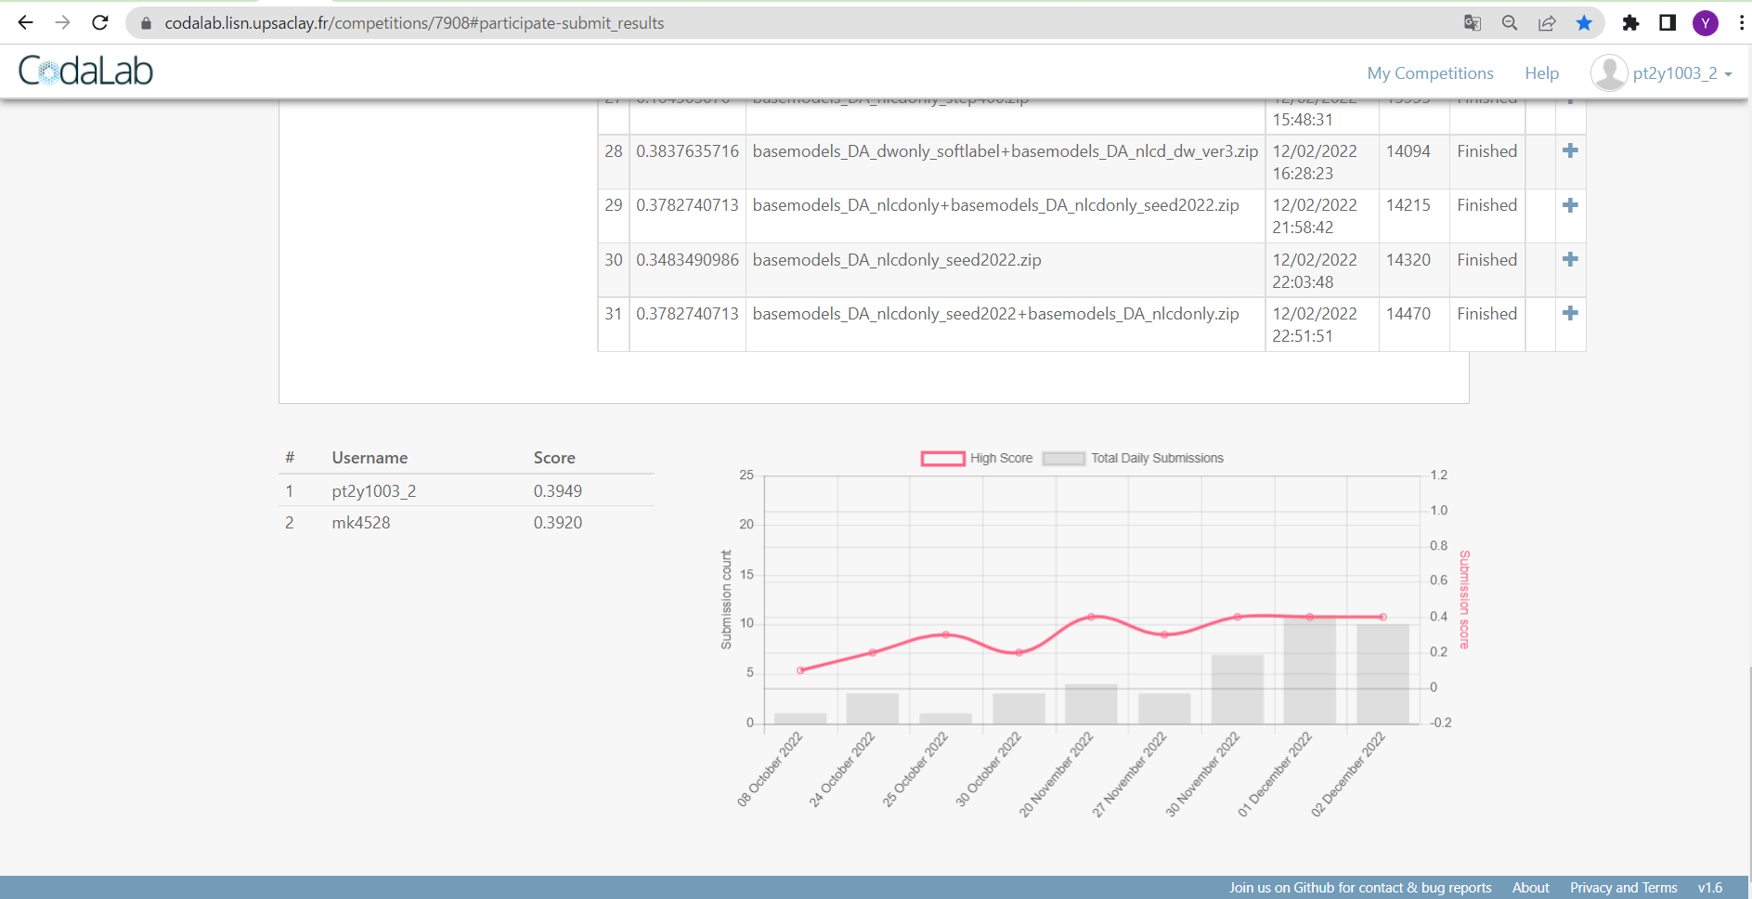

Performance Evaluation
We used (copy environment of) DFC2021 contest web page “Codalab” which can evaluate test loss/gain IoUs from 2013 to 17 in the exactly same way with the real contest
Thanks to professor Yokoya who was one of DFC2021 contest organizer
Figure1: Codalab web page
Mean IoU of submitted model
ranking
History of mean IoU of submitted models

Slide 5
Dataset and Data Visualization
The input images comprise 9 layers (2013 and 2017):
NAIP (2 layers): 1m-resolution 4-band (red, green, blue, and near-infrared)
Landsat (5 layers): 30m-resolution 9-band image from the Landsat-8 satellite
NLCD (2 layers): 30m-resolution coarse land cover labels
2250 aligned tiles of dimensions not exceeding 4000 × 4000 covering the state of Maryland
The training data:
2250 NAIP-aligned tiles (1m /pixel, high resolution)
NLCD (30m/pixel, low resolution)

Slide 6
Dataset and Data Visualization
NLCD class name |  | Loss Color | Gain Color | Target class name | Approximate class frequencies
 |  |  |  |  | Water | TC | LV | Improv.
11 | Open Water |  |  | Water | 98% | 2% | 0% | 0%
21 | Developed, Open Space | -- | -- | -- | 0% | 39% | 49% | 12%
22 | Developed, Low Intensity | -- | -- | -- | 0% | 31% | 34% | 35%
23 | Developed, Medium Intensity |  |  | Impervious | 1% | 13% | 22% | 64%
24 | Developed, High Intensity |  |  | Impervious | 0% | 3% | 7% | 90%
31 | Barren Land (Rock/Sand/Clay) | -- | -- | -- | 5% | 13% | 43% | 40%
41 | Deciduous Forest |  |  | Tree Canopy | 0% | 93% | 5% | 0%
42 | Evergreen Forest |  |  | Tree Canopy | 0% | 95% | 4% | 0%
NLCD class name |  | Loss Color | Gain Color | Target class name | Approximate class frequencies
 |  |  |  |  | Water | TC | LV | Improv.
43 | Mixed Forest |  |  | Tree Canopy | 0% | 92% | 7% | 0%
52 | Shrub/Scrub |  |  | Tree Canopy | 0% | 58% | 38% | 4%
71 | Grassland/ Herbaceous |  |  | Low Vegetation | 1% | 23% | 54% | 22%
81 | Pasture/Hay |  |  | Low Vegetation | 0% | 12% | 83% | 3%
82 | Cultivated Crops |  |  | Low Vegetation | 0% | 5% | 92% | 1%
90 | Woody Wetlands |  |  | Tree Canopy | 0% | 94% | 5% | 0%
95 | Emergent Herbaceous Wetlands |  |  | Tree Canopy | 8% | 86% | 5% | 0%

Slide 7
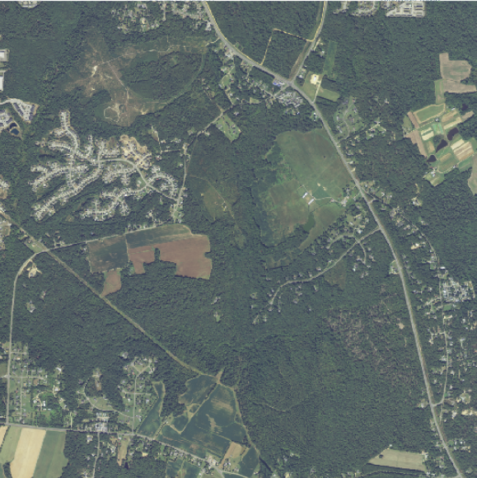
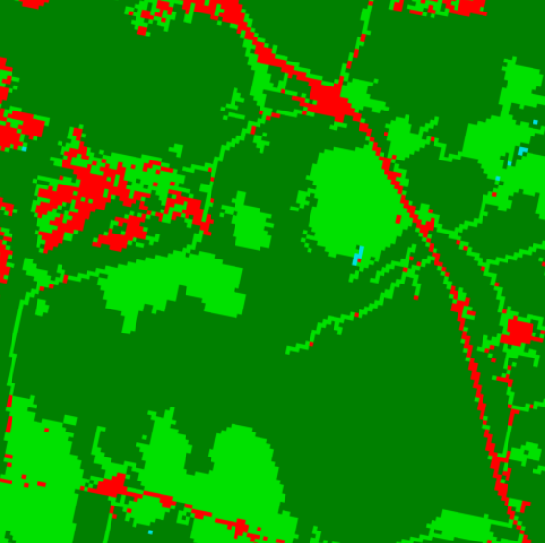
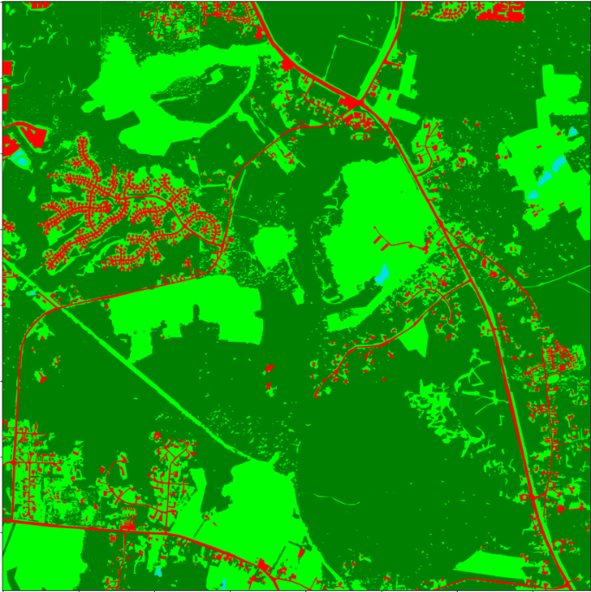
Dataset and Data Visualization
The test data:
50 NAIP-aligned tiles (1m / pixel) selected from the 2250 training tiles
GroudWork software to create high-resolution labeling
NAIP 2013
NLCD 2013 label
high-resolution label for NAIP2013

Slide 8
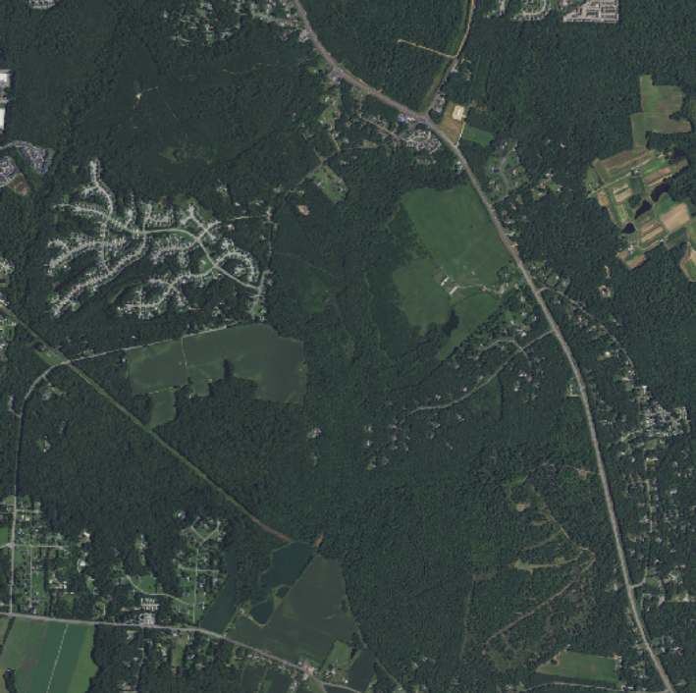
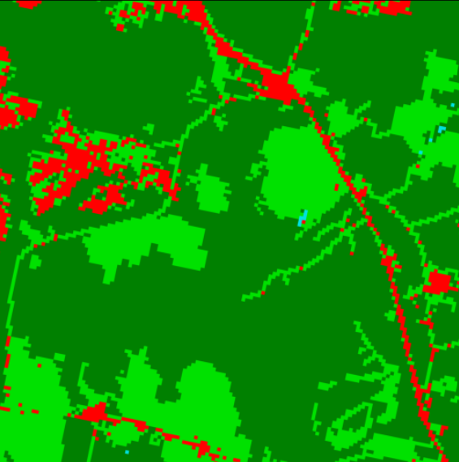
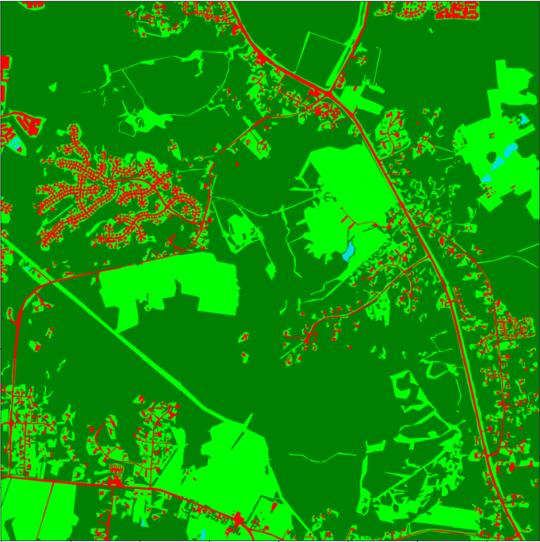
Dataset and Data Visualization
The test data:
50 NAIP-aligned tiles (1m / pixel) selected from the 2250 training tiles
GroudWork software to create high-resolution labeling
NAIP 2017
NLCD 2016 label for
high-resolution label for NAIP2017

Slide 9
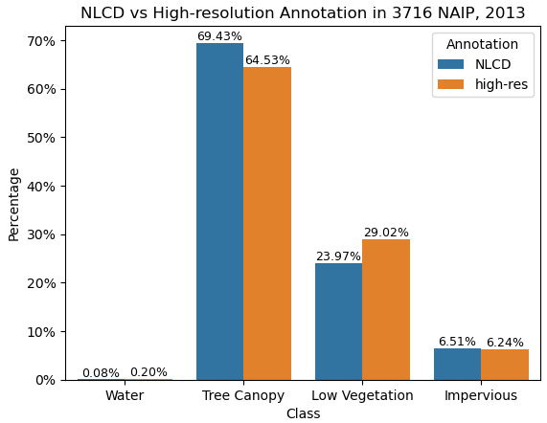
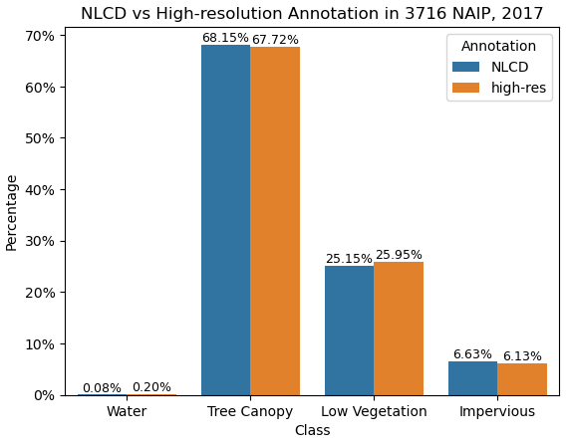
Dataset and Data Visualization
NLCD labels vs high resolution labels by Groundwork:
comparison in 2013
comparison in 2017

Slide 10
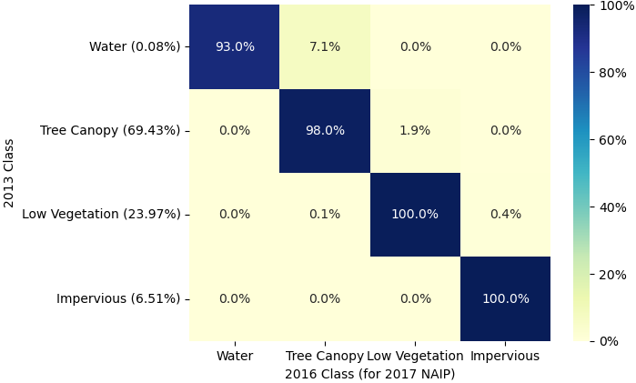
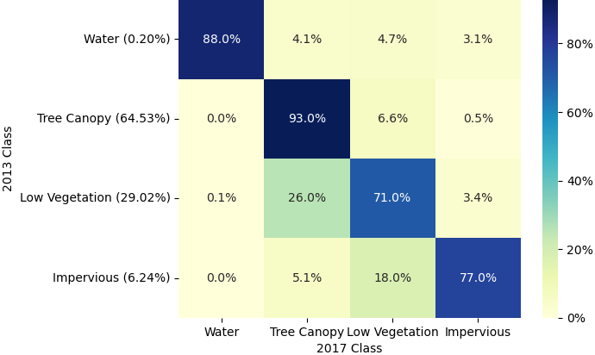
Dataset and Data Visualization
NLCD labels vs high resolution labels by Groundwork:
change of NLCD from 2013 to 2016
change of high-res. labels from 2013 to 2017

Slide 11
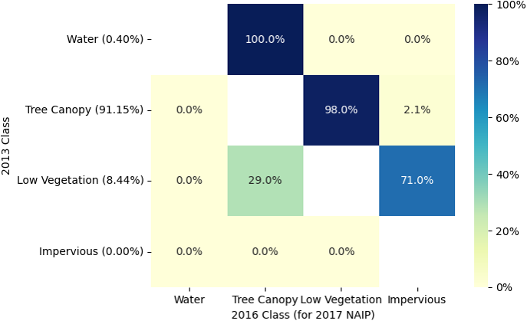
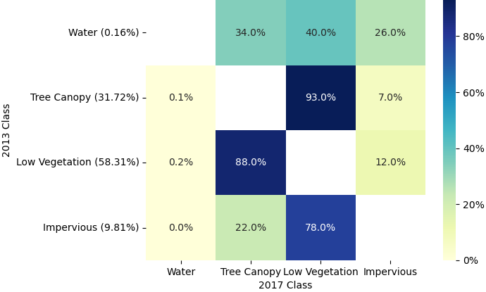
Dataset and Data Visualization
NLCD labels vs high resolution labels by Groundwork:
except for non-change pixels
except for non-change pixels

Slide 12
Methodology and Results
NLCD Diff:
only input from the 2013 and 2016 NLCD layers
for each pixel, and high-resolution classes were assigned
does not require training

Slide 13
Methodology and Results
One Layer Convolution Neural Network:
fully convolutional network (FCN) with a single convolutional layer
input channels = 4 (Red, Green, Blue, and Near-Infrared)
output classes = 5 (Water, Tree Canopy, Low Vegetation, Impervious, and None)
filter size = 3, stride = 1, and padding = 1.
cross-entropy as the loss function

Slide 14
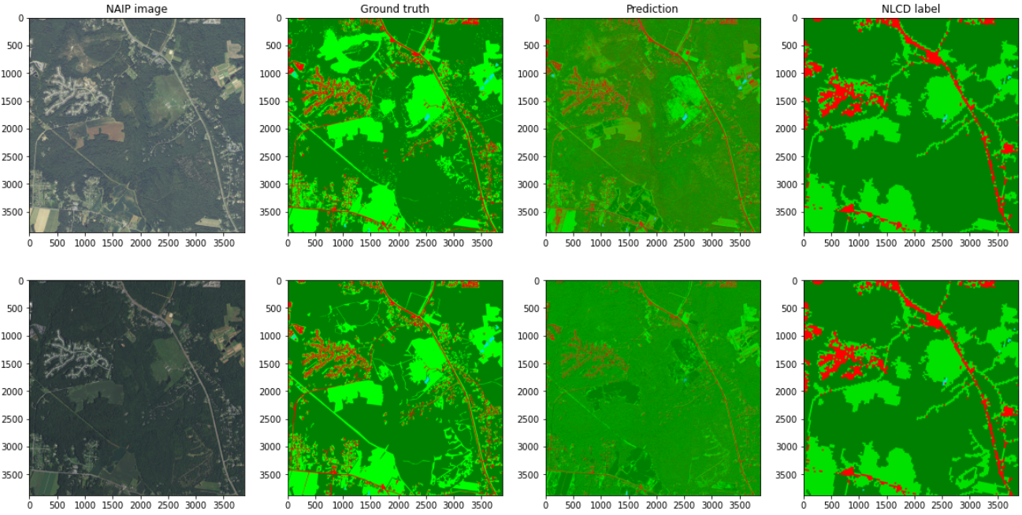
Methodology and Results
One Layer Convolution Neural Network:

Slide 15
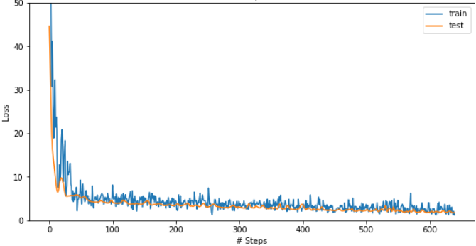
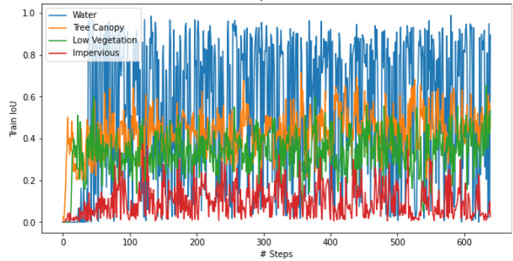
Methodology and Results
One Layer Convolution Neural Network:
the training and test losses
the training IoU scores for the target four classes

Slide 16
Goals and Next Steps
Our Approach
Convolutional neural networks:
Two separate for two years (FCN / tile)
One on both years (FCN / all)
U-Net (all datasets)
Trian models on all training datasets
Research for potential appropriate models

Slide 17
Using Dynamic World Labels

Slide 18
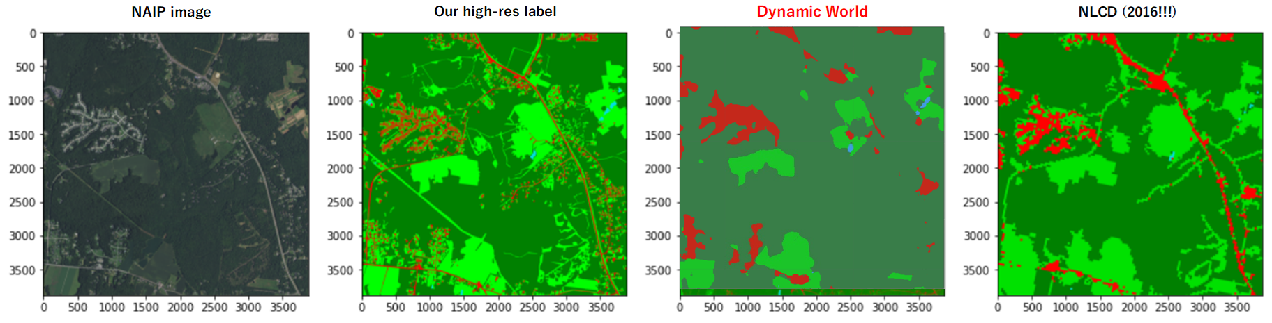
What is Dynamic World labels (DW)?
10m-res land-cover label made by deep learning model for Sentinel-2 imagery [1]
Available Globally & Near Real-Time on GEE (Google Earth Engine) from 2015.6
9 classes (water, trees, grass, flooded vegetation, crops, shrub & scrub, built, bare, snow & ice), class probabilities also available
Classified these 9 classes into [water, TC, LV, Impervious and None] by their colors
Despite of its higher-res, DW looks more rough than NLCD in general (for other images, too)
Figure1: Comparison of NLCD (2016) and Dynamic World label (2017) for NAIP 3716 (2017)

Slide 19
Why we also tried to use DW (not only NLCD)?
DW can be used for anytime from 2015 and anywhere on the earth with finest resolution as a global label (Figure1). So, it is of interest to see the performance when using DW in stead of NLCD
Also tried to combine NLCD and DW, since many local popular labels such as NLCD for US and CORINE Land Cover for Europe [3] which DW can be combined with to improve performance
Figure1: List of global labels (resolution finer than 1 km) [1], [2]
Global label | time | resolution
Dynamic World [1] | 2015– last day | 10 m
iMap 1.0 [2] | 1985–2020 | 30 m
Finer Resolution Observation and Monitoring of Global Land Cover | 2010, 2015 and 2017 | 10 m and 30 m
Global land cover | 2000, 2010 and 2020 | 30 m
Global label (cont.) | time | resolution
Copernicus Global Land Service | 2015–2019 | 100 m
European Space Agency Climate Change Initiative | 1992–2018 | 300 m
NASA MCD12Q1 (MODIS Land Cover Type (MLCT) series) | 2001–2018 | 500 m

Slide 20
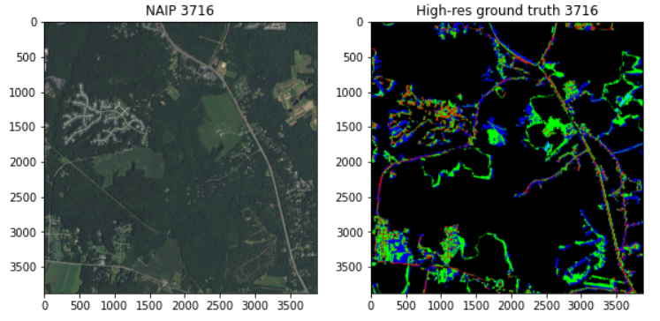
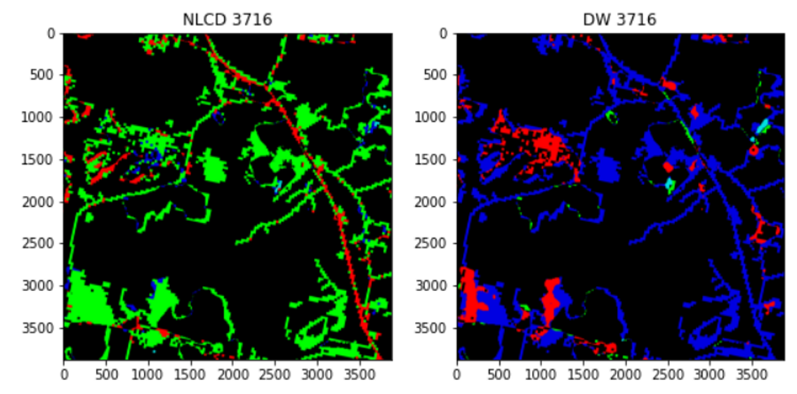
How DW is different from NLCD?
DW and NLCD are different in 20% pixels mainly along edges and loads
DW is fond of TC (colored in blue), while NLCD is fond of LV (light green)
Figure1: Comparison of NLCD (2016) and Dynamic World label (2017) over total 2250 NAIP images
Figure2: Comparison of NLCD (2016), Dynamic World label (2017) and our high-resolution manual label for NAIP 3716 (2017)
*1 Pixels where NLCD and DW are the same are colored in black
*2 Tree Canopy is colored in blue for visual purpose

Slide 21
Naïve performance comparison: NLCD and DW
Comparing with our 4 manual labels, DW is better than NLCD except LV, with more balanced performance over 4 classes in terms of precision [a] and IoU [c]
When DW and NLCD are different, DW is better for many cases [b]
Figure1: Comparison of NLCD (2016) and Dynamic World label (2017) over 4 manual ground-truth labels (3880 by 3880)
[a]
Figure2: IoU comparison over 4 manual ground-truth labels
[c]
[b]
*We marked largest %pixels over the 4 classes in red

Slide 22
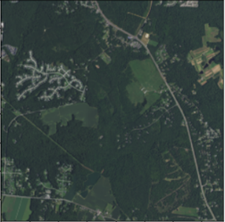
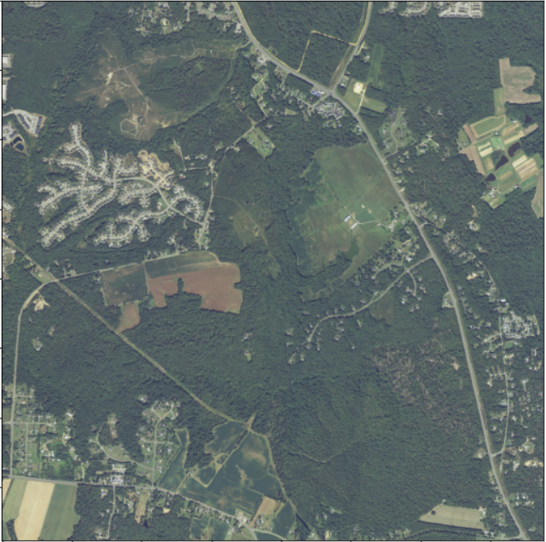
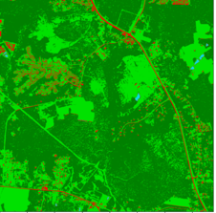
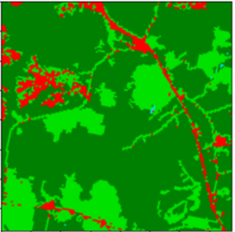
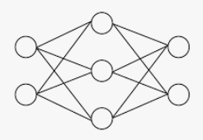
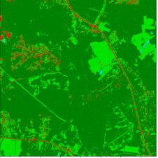
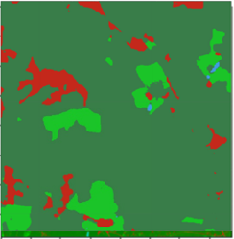
Performance comparison of NLCD vs DW
Experiment setting: Since no DW labels for 2013, we trained models on pairs of “NAIP (2017) & DW(2017)” or “NAIP (2017) & NLCD (2016)”, applied trained models to both 2013 and 2017 and compared loss/gain IoUs from 13 to 17
Figure1: (initially planned) Experiment flow
NAIP 2017 and their NLCD/DW
train
get model
NAIP image
inference
predicted high-res labels
2013
Compute Loss/Gain IoUs
OR
2017

Slide 23
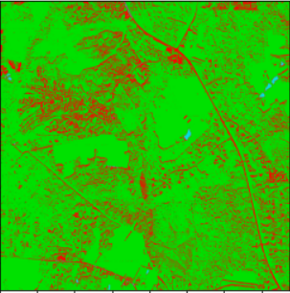
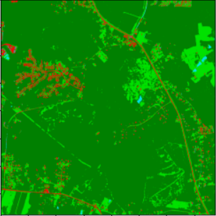
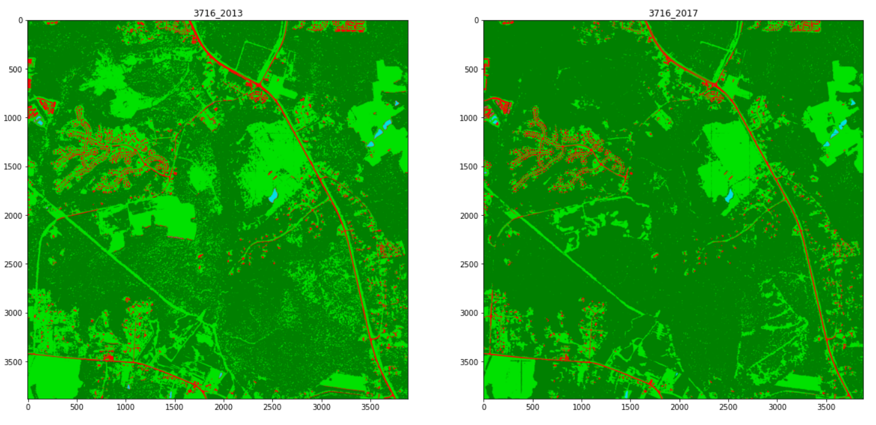
Data Augmentation for Brightness
However, since NAIP 2013 images are brighter than 2017, naïve application of models trained on NAIP 2017 to NAIP 2013 caused failure (Figure1)
So, we applied data augmentation for brightness. Specifically, we prepared one brighter image for each NAIP 2017 image with the same NLCD/DW label
Dataset: 2000 NAIP images and their NLCD/DW labels, augmented to 4000 pairs in total. We trained 5-layer FCN for 0.5 epoch with batch size 2
Figure1: Model prediction for NAIP 3716 with and without Data Augmentation (trained on NLCD 2016)
Without DA
With DA
2013
2017
2013
2017

Slide 24
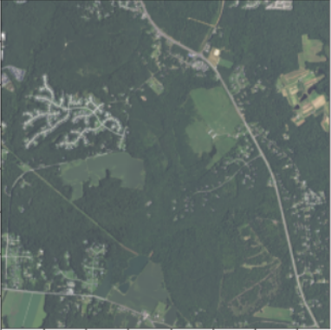
Performance comparison of NLCD vs DW (final)
Modified experiment flow after adopting data augmentation for brightness:
Figure1: Final experiment flow with Data Augmentation
NAIP 2017 and their NLCD/DW (augmented)
train
get model
NAIP image
inference
predicted high-res labels
2013
&
Compute Loss/Gain IoUs
OR
2017
&

Slide 25
Results—DW has comparable performance to NLCD
We compared the following 4 models:
Trained on NLCD 2016
DW 2017 hard labels (we summed 9 class probabilities into 4 classes and took argmax to make a hard label)
DW 2017 soft labels (we summed 9 class probabilities into 4 classes to make a soft label)
Model average of the 1st and 3rd model
DW soft label has similar performance to NLCD
DW soft label is slightly better than DW hard label except Impervious loss (I-)
Model average of NLCD and DW(soft label) performed better than both for all categories except W loss (W-). Its average IoU was 0.395
Although we tried many candidates to combine NLCD and DW, nothing other than the simple model average worked well
Figure1: Loss/gain IoUs

Slide 26
Conclusion

Slide 27
Conclusion
We investigated weakly supervised land-cover change classification
(if any) BraBraBra…
On Dynamic World label (DW):
DW has comparable performance as a weak label to NLCD. So, we might not have to use NLCD anymore
Using probabilities rather than deterministic labels leads to slightly better performance (for DW)
Model average (of output probabilities) of NLCD and DW gives slightly better performance than either NLCD or DW only
About model uncertainty:
brabrabra…

Slide 28
Appendix.

Slide 29
Appendix. Using Dynamic World Labels

Slide 30
How to Download DW labels
We downloaded DW labels from GEE using python API for every coordinate of NLCD labels
Period: June 23rd to Sep 29th, 2017
For label band, we took the mode class for each pixel over the period
For probability band, we took the average of probability for each pixel and each class over the period
Considering that DW is 10m-resolution, to save the data size, we down-sampled DW by 1/10, e.g. 388 by 388 for originally 3880 by 3880 label. We also rounded the probabilities by multiples of 0.5% and saved as uint8 upon multiplied by 200
When using in training, we transformed them into probabilities again

Slide 31
Why Data Augmentation and not Standardization?
In fact, in baseline model git for the DFC 2021 contest, they standardized images as
NAIP2013 --> (NAIP2013 - NAIP2013.mean)/NAIP2013.std
NAIP2017 --> (NAIP2017 - NAIP2017.mean)/NAIP2017.std
In this case, since both years are for Maryland, the standardized distribution of RGB (and infrared) numbers should be similar between 2013 and 2017
However, AoI and dataset for model training can be completely different! Then, the standardized distributions of RGB-numbers can be quite different, which can still cause failure in model prediction
Ex) we may want to train a model on Maryland 2017 but apply the model to Las Vegas 2013!
This is why we preferred data augmentation for brightness which forces models to learn from relative difference of brightness of each class within an image (e.g. TC and LV)

